Slide 1
EMPLOYEE SALARY PREDICTION USING MACHINE LEARNING
Presented By:
Vikas Raikwar
Samrat Ashok Technological Institute
Computer Science and Engineering

Slide 2
OUTLINE
Problem Statement
System Development Approach
Algorithm & Deployment (Step by Step Procedure)
Result
Conclusion
Future Scope
References

Slide 3
PROBLEM STATEMENT
In today’s competitive job market, estimating a fair salary based on an employee’s education, experience, job type, and other demographics is essential for HR professionals and job seekers alike.
This project aims to build a predictive system using machine learning that accurately estimates whether a person’s salary is above or below 50k per year, based on census income data. The main goal is to improve hiring strategies, reduce bias, and assist in data-driven HR decisions.

Slide 4
SYSTEM APPROACH
System requirements Python
Jupyter Notebook/ VS Code Streamlit for Web App development
Library required to build the model pandas, numpy
scikit- learn lightgbm matplotlib, seaborn streamlit

Slide 5
ALGORITHM & DEPLOYMENT
Load dataset and clean missing values.
Chose LightGBM, a gradient boosting framework known for performance and speed.
Train the LightGBM classifier. Evaluate using accuracy, pressision, and confusion matrix.
Developed an interactive frontend using Streamlit where users can input their profiles to predict salary class.
Hosted locally and optionally on platform like Streamlit.

Slide 6
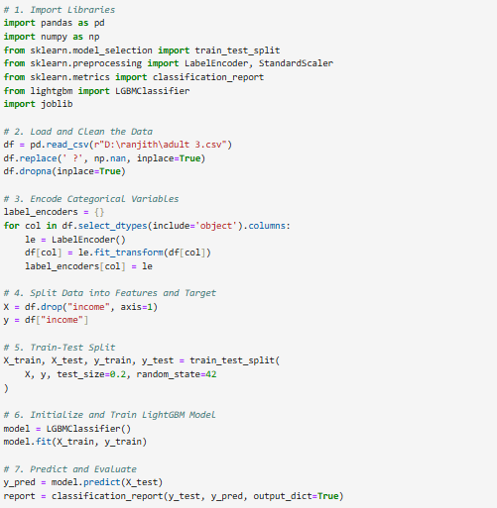
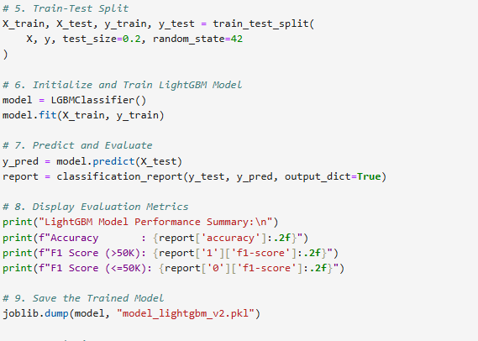
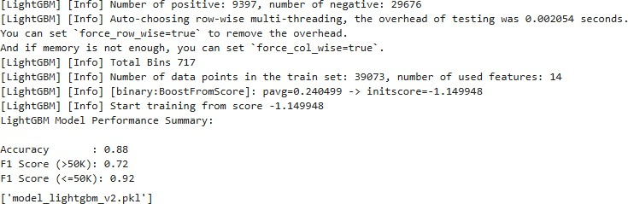
RESULT

Slide 7
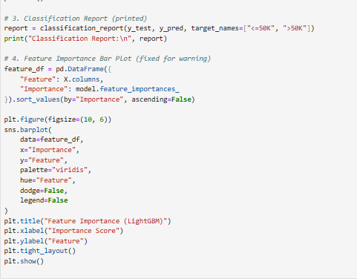
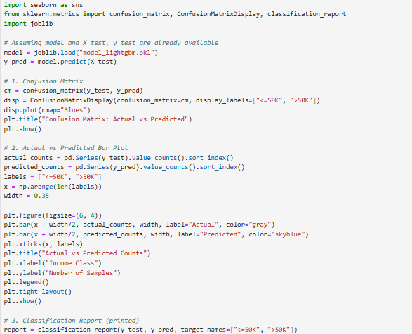
RESULT

Slide 8
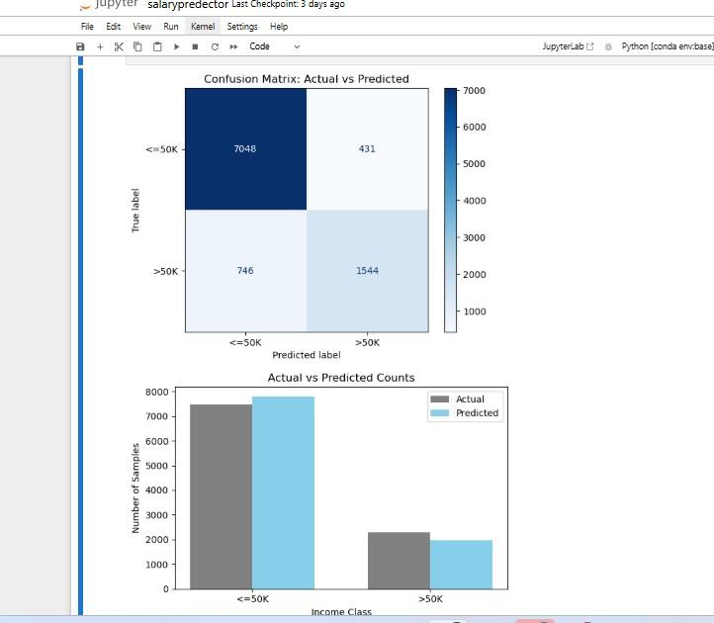
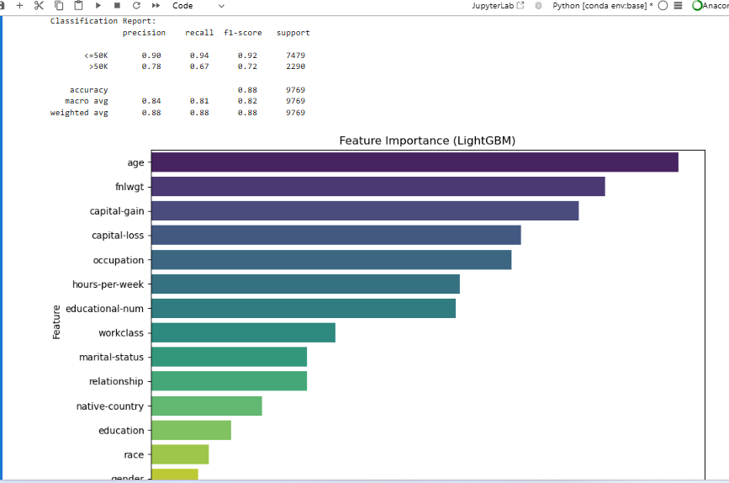
RESULT

Slide 9
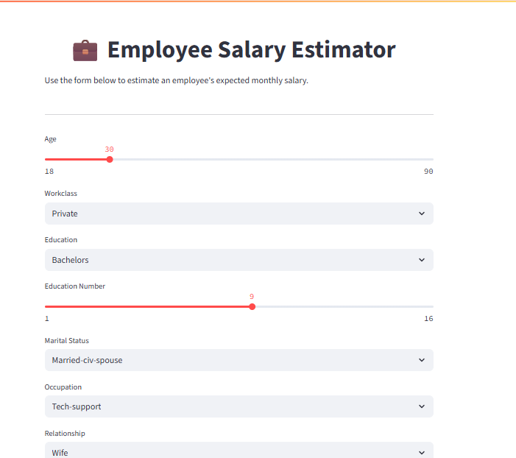
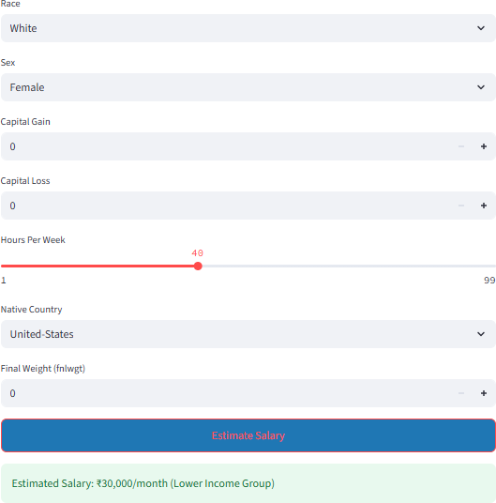
RESULT

Slide 10
RESULT
Git hub link: https://github.com/VikasBaller/Employee-salary-prediction

Slide 11
CONCLUSION
The project successfully demonstrates the use of machine learning to predict whether an individual's income exceeds $50,000 based on demographic and occupational features. The LightGBM model provided high accuracy and fast training performance. Challenges included handling imbalanced classes and encoding categorical variables properly. The Streamlit app offers an intuitive interface for non-technical users to use the model effectively.
.

Slide 12
REFERENCES
UCI Machine Learning Repository: https://archive.ics.uci.edu/ml/datasets/adult
LightGBM Documentation: https://lightgbm.readthedocs.io
Scikit-learn Documentation: https://scikit-learn.org
Streamlit Docs: https://docs.streamlit.io

Slide 13
THANK YOU

